Slide 1
BIEN 401 Biomedical Mass Transport Class 2 Thermodynamics: Review
notes prepared by
Dr. Louis Reis
Created on 3/3/2022

Slide 2
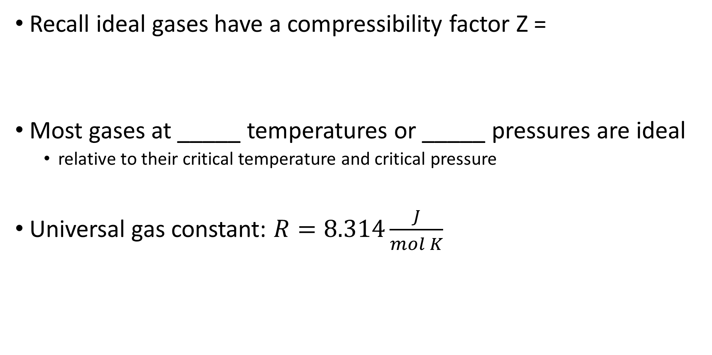
Ideal Gas Equations
Recall ideal gases have a compressibility factor Z =
Most gases at _____ temperatures or _____ pressures are ideal
relative to their critical temperature and critical pressure
Universal gas constant: $R=8.314\frac{J}{mol K}$

Slide 3
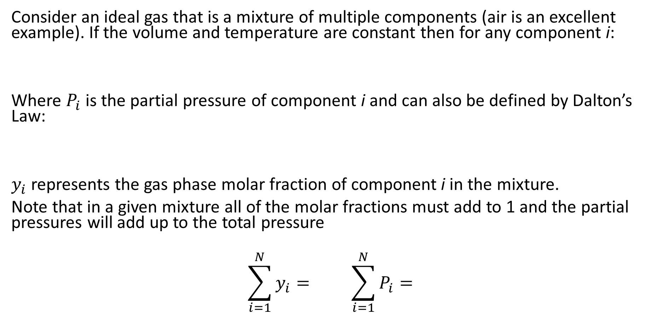
Partial Pressures
Consider an ideal gas that is a mixture of multiple components (air is an excellent example). If the volume and temperature are constant then for any component i:
Where $P_{i}$ is the partial pressure of component i and can also be defined by Dalton’s Law:
$y_{i}$ represents the gas phase molar fraction of component i in the mixture.
Note that in a given mixture all of the molar fractions must add to 1 and the partial pressures will add up to the total pressure
$$\sum_{i=1}^{N}{y_{i}}= \sum_{i=1}^{N}{P_{i}}=$$

Slide 4
Vapor-Liquid Mixtures
Consider a mixture of vapor and liquid composed of different components but is in phase equilibrium. Some of the initial liquid components will vaporize into the vapor phase, and some of the vapor will dissolve into the liquid.
Examples:
Humidity- amount of water droplets in air
Carbonation – dissolved CO₂ in water

Slide 5
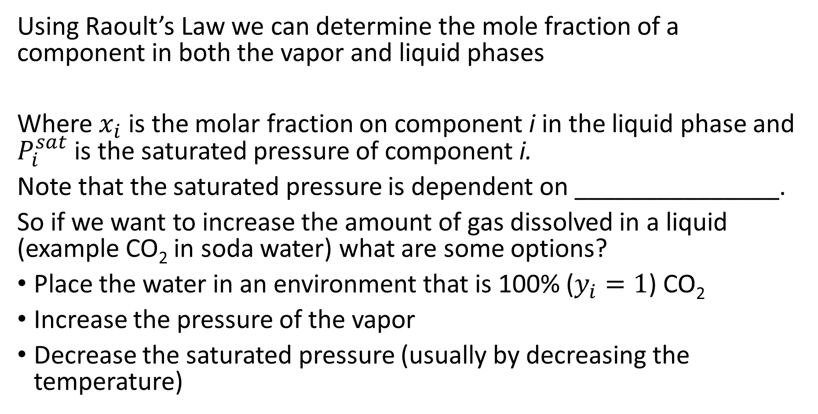
Raoult’s Law
Using Raoult’s Law we can determine the mole fraction of a component in both the vapor and liquid phases
Where $x_{i}$ is the molar fraction on component i in the liquid phase and $P_{i}^{sat}$ is the saturated pressure of component i.
Note that the saturated pressure is dependent on _______________.
So if we want to increase the amount of gas dissolved in a liquid (example CO₂ in soda water) what are some options?
Place the water in an environment that is 100% ($y_{i}=1$) CO₂
Increase the pressure of the vapor
Decrease the saturated pressure (usually by decreasing the temperature)

Slide 6
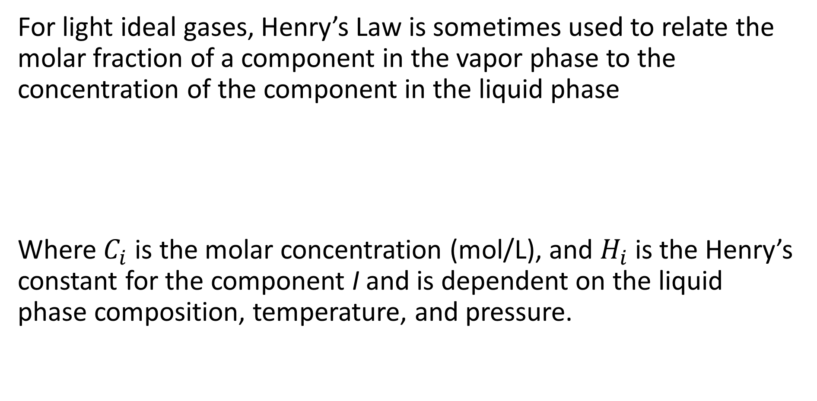
Henry’s Law
For light ideal gases, Henry’s Law is sometimes used to relate the molar fraction of a component in the vapor phase to the concentration of the component in the liquid phase
Where $C_{i}$ is the molar concentration (mol/L), and $H_{i}$ is the Henry’s constant for the component I and is dependent on the liquid phase composition, temperature, and pressure.

Slide 7
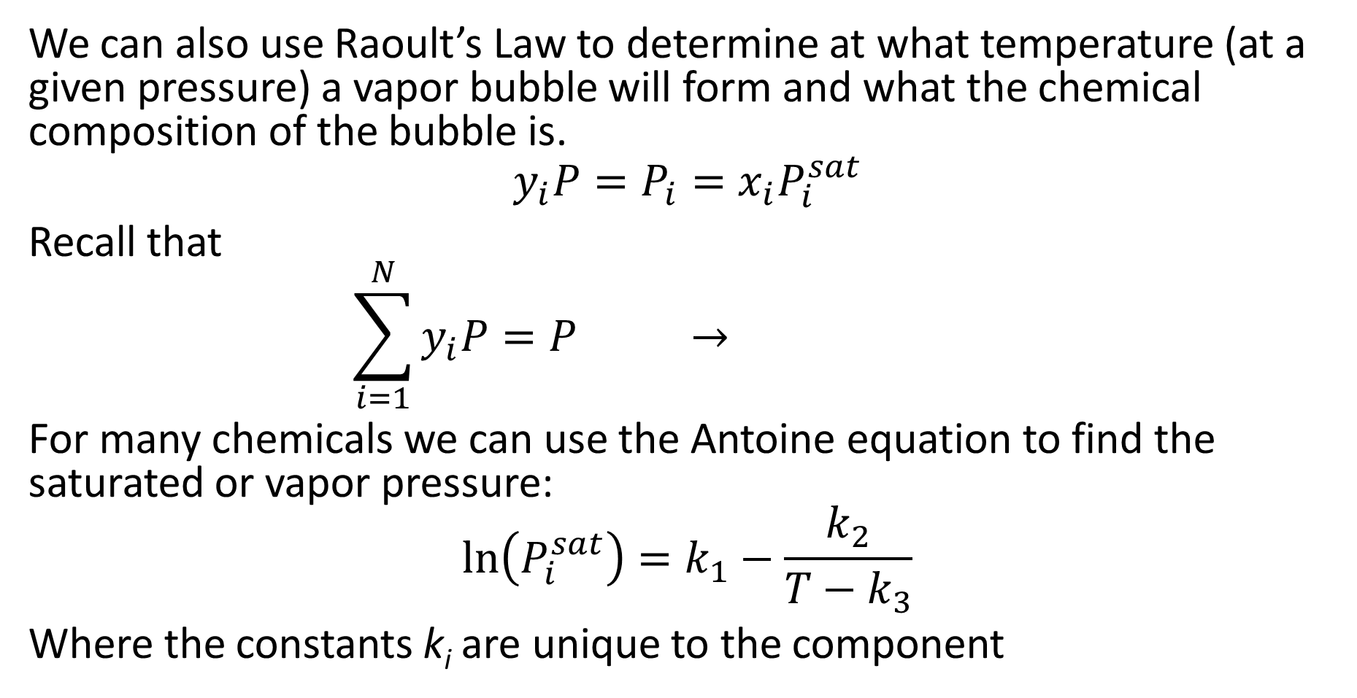
Raoult’s Law and Bubble Point
We can also use Raoult’s Law to determine at what temperature (at a given pressure) a vapor bubble will form and what the chemical composition of the bubble is.
$$y_{i}P=P_{i}=x_{i}P_{i}^{sat}$$
Recall that
$$\sum_{i=1}^{N}{y_{i}P}=P →$$
For many chemicals we can use the Antoine equation to find the saturated or vapor pressure:
$$\ln\left(P_{i}^{sat}\right)=k_{1}−\frac{k_{2}}{T−k_{3}}$$
Where the constants k_{i} are unique to the component

Slide 8
Raoult’s Law and Bubble Point example
Consider a solution made of benzene, toluene, and ethylbenzene. The liquid molar fractions of the chemicals along with their boiling points and Antoine constants are in the table below.
At what temperature will a vapor bubble form at 1 atm? And what is the chemical composition of the bubble?
*note: the Antoine constants require that the temperature be in K and the pressure in mmHg
chemical | Molar fraction (x_{i}) | Boiling Point (K) | k₁ | k₂ | k₃
Benzene (C₆H₆) | 0.25 | 353.3 | 15.9008 | 2788.51 | 52.36
Toluene (C₇H₈) | 0.45 | 383.8 | 16.0137 | 3096.52 | 53.67
Ethylbenzene (C₈H₁₀) | 0.30 | 409.3 | 16.0195 | 3279.47 | 59.95

Slide 9
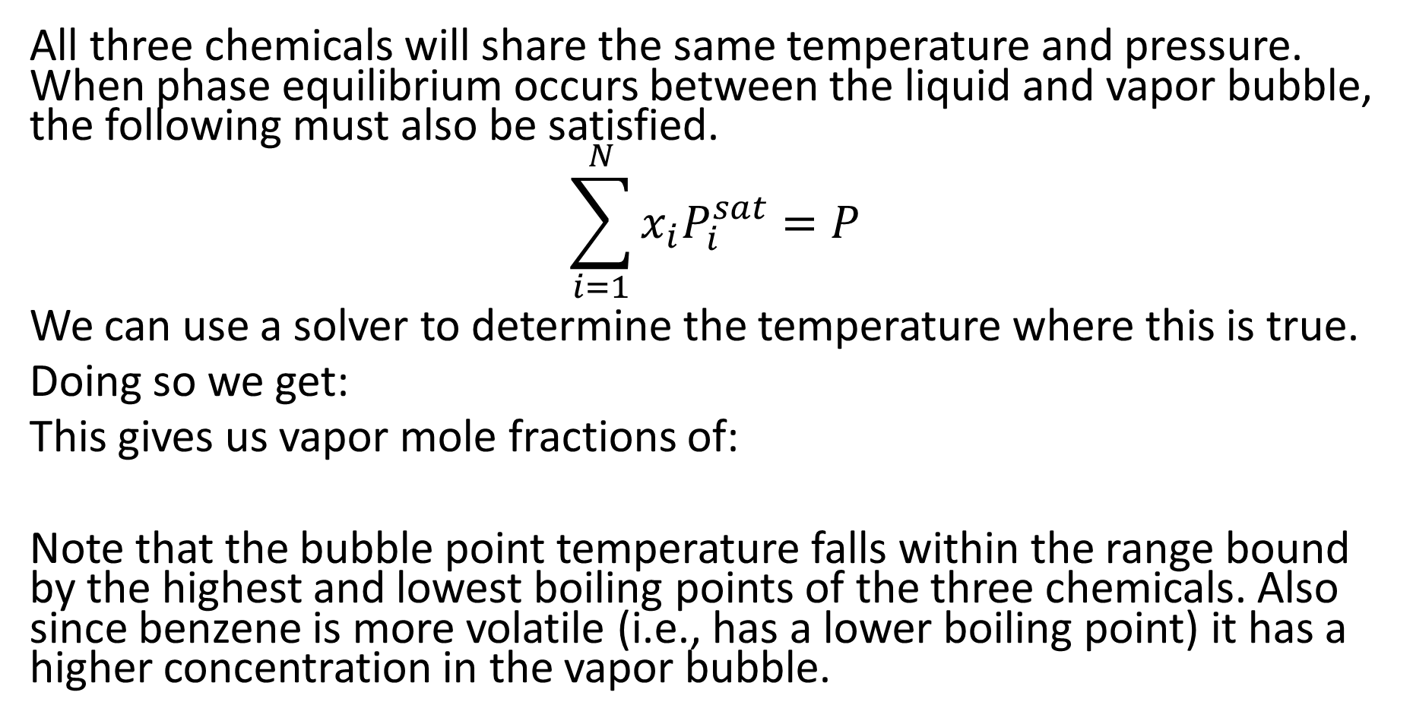
Raoult’s Law and Bubble Point solution
All three chemicals will share the same temperature and pressure. When phase equilibrium occurs between the liquid and vapor bubble, the following must also be satisfied.
$$\sum_{i=1}^{N}{x_{i}P_{i}^{sat}}=P$$
We can use a solver to determine the temperature where this is true.
Doing so we get:
This gives us vapor mole fractions of:
Note that the bubble point temperature falls within the range bound by the highest and lowest boiling points of the three chemicals. Also since benzene is more volatile (i.e., has a lower boiling point) it has a higher concentration in the vapor bubble.

Slide 10
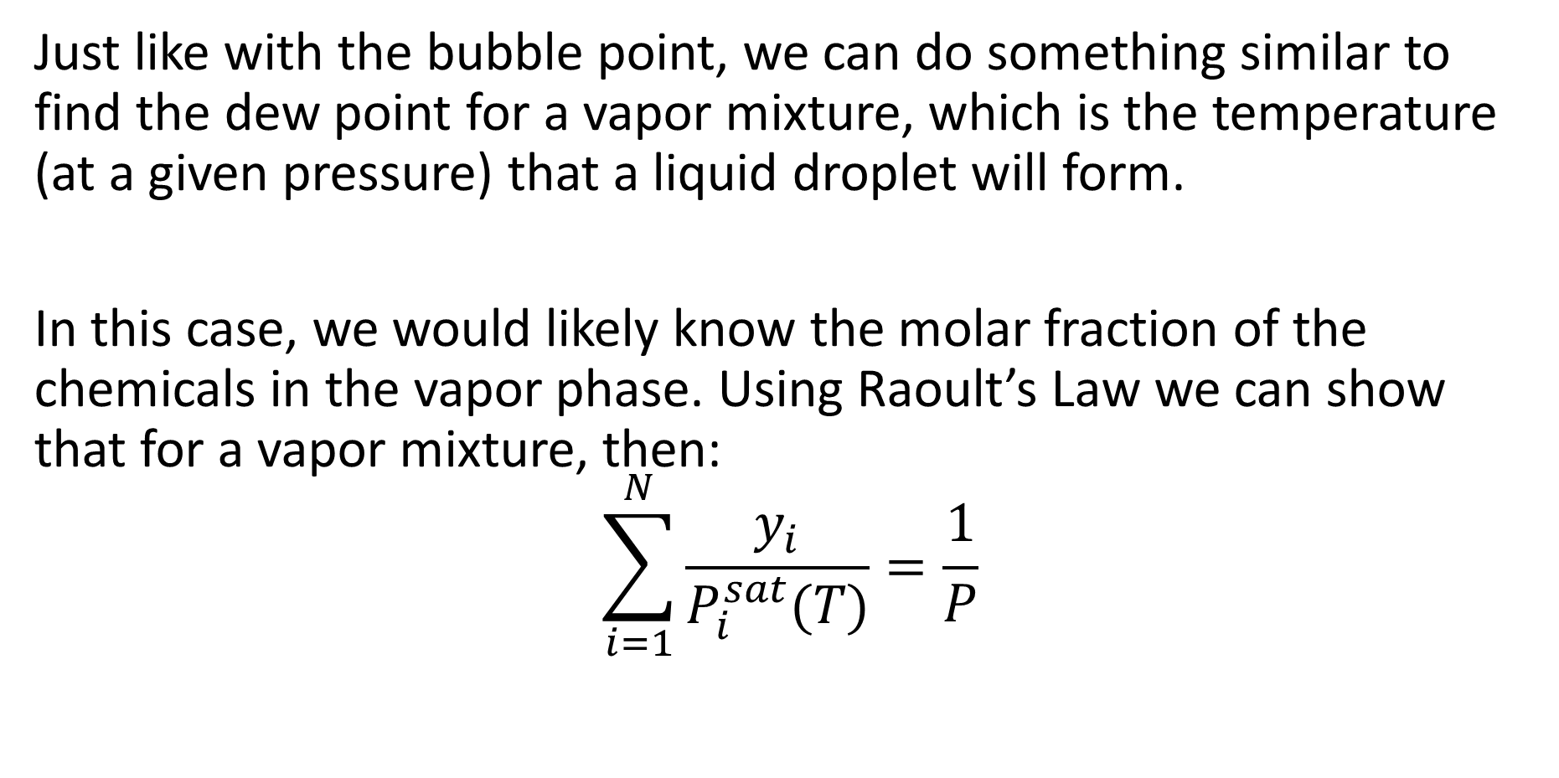
Raoult’s Law and Dew Point
Just like with the bubble point, we can do something similar to find the dew point for a vapor mixture, which is the temperature (at a given pressure) that a liquid droplet will form.
In this case, we would likely know the molar fraction of the chemicals in the vapor phase. Using Raoult’s Law we can show that for a vapor mixture, then:
$$\sum_{i=1}^{N}{\frac{y_{i}}{P_{i}^{sat}(T)}}=\frac{1}{P}$$

Slide 11
Raoult’s Law - Problem
Consider a tank of benzene at ambient conditions (25ºC and 1 atm). Given that benzene vapor is flammable when its vapor composition lies between 1.4% and 8.0%, determine the mole fraction of benzene in the vapor phase and if it is flammable.
If the tank was placed in a refrigerated space maintained at 4.4ºC (and 1 atm), would there be any concern?
Use the constants for benzene on slide 8.

Slide 12
Raoult’s Law - Solution

Slide 13
Raoult’s Law - Solution

Slide 14
Raoult’s Law - Solution

Slide 15
Fugacity
You may have noticed in the past example and last few topics on Raoult’s and Henry’s Laws that even during equilibrium there can be different concentrations of a chemical at a surface (e.g., bubble or droplet surface)
Many people think that the relationship between chemical equilibrium and concentrations are similar to the relationship between thermal equilibrium and temperature or mechanical equilibrium and pressure (e.g., temperature is constant throughout the system)
For some systems this is true, but it is not the governing law.
For chemical equilibrium the ______________________ for all components involved are equal.
Because chemical potentials are difficult to quantify, we use ____________ instead. So at equilibrium, a given chemical species has the same partial fugacity f_{i} in each existing phase.

Slide 16
Osmotic Pressure
Consider two open tanks filled with a common solvent. Tank A has the solvent along with some solute dissolved in it. Tank B only has the solvent (free of any solute). The two tanks are separated by a semi-permeable membrane that allows the solvent to pass through but not the solute.
To balance the fugacity of the solute, water from tank B will flow into tank A and lower the mole fraction of the solute. This movement of water is called _____________.
At some point enough water will have transferred from tank B to tank A, that the increased hydrostatic pressure will prevent the water from flowing into tank A. This difference between the hydrostatic pressures is the osmotic pressure.

Slide 17
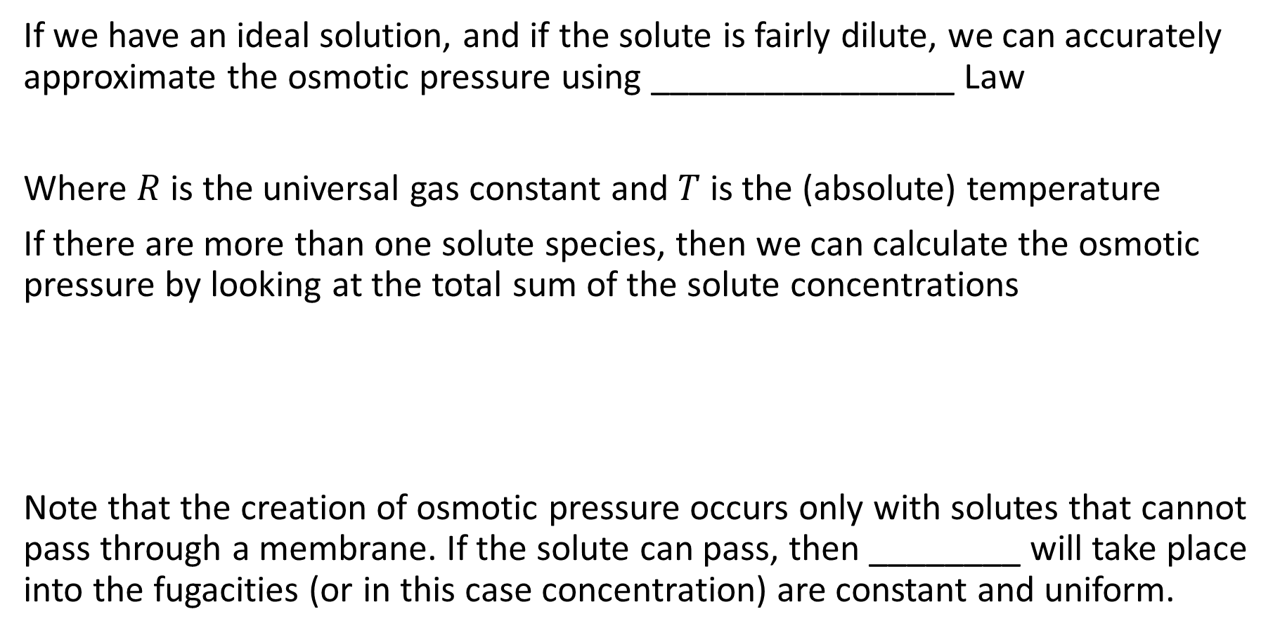
Osmotic Pressure
If we have an ideal solution, and if the solute is fairly dilute, we can accurately approximate the osmotic pressure using ________________ Law
Where $R$ is the universal gas constant and $T$ is the (absolute) temperature
If there are more than one solute species, then we can calculate the osmotic pressure by looking at the total sum of the solute concentrations
Note that the creation of osmotic pressure occurs only with solutes that cannot pass through a membrane. If the solute can pass, then ________ will take place into the fugacities (or in this case concentration) are constant and uniform.

Slide 18
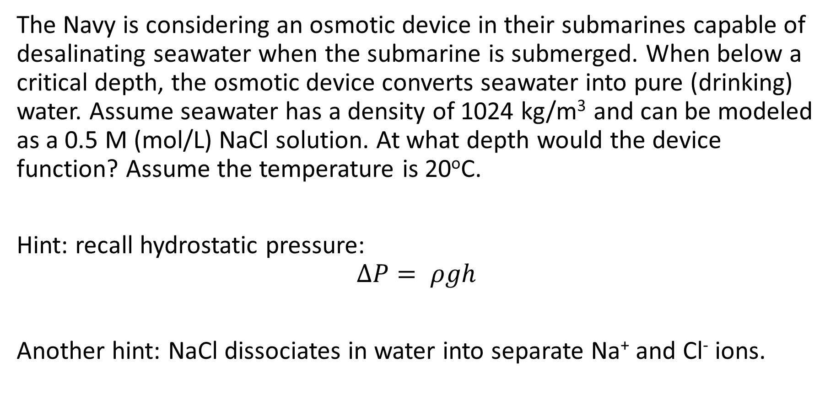
Osmotic Pressure - Problem
The Navy is considering an osmotic device in their submarines capable of desalinating seawater when the submarine is submerged. When below a critical depth, the osmotic device converts seawater into pure (drinking) water. Assume seawater has a density of 1024 kg/m³ and can be modeled as a 0.5 M (mol/L) NaCl solution. At what depth would the device function? Assume the temperature is 20ºC.
Hint: recall hydrostatic pressure:
$$∆P= ρgh$$
Another hint: NaCl dissociates in water into separate Na⁺ and Cl⁻ ions.

Slide 19
Osmotic Pressure - Solution

Slide 20
Osmotic Pressure - Solution

Slide 21
Osmotic Pressure - Problem
Osmotic pressure can be useful for determining the molecular weights of large macromolecules such as proteins.
Consider a solution containing a protein that exerts an osmotic pressure equivalent to 8 cm of water. The mass concentration of the protein is 15 g/L. Determine the molecular weight of this protein. Assume the solution is at 25ºC.

Slide 22
Osmotic Pressure - Solution

Slide 23
Osmotic Pressure - Solution

